Slide 1

A
Project Review
Project title: Intelligent Energy Consumption Analytics for Smart Buildings
Submitted by
Batch No:
17
2420030235 – Ch . Shravanya
2420030116 - M . Swetha
2420090031- K . Charanya
Under the Esteemed guidance of
Mrs. Dr. Sirisha
Assistant Professor
Department of Computer Science and Engineering
Koneru Lakshmaiah Education Foundation
(Deemed to be University estd. u/s. 3 of the UGC Act, 1956)
Off-Campus: Bachupally-Gandimaisamma Road, Bowrampet, Hyderabad, Telangana - 500 043.
Phone No: 7815926816, www.klh.edu.in

Slide 2
Outline of the presentation
Problem Statement
Abstract
Project flow diagram
Literature Survey
Objectives with justification
Research gaps
Novelty/Innovation/Feseability
Tools
Project plan

Slide 3
Problem Statement
Smart buildings generate large amounts of energy-related data from appliances, sensors, environmental conditions, and building systems.
Traditional energy monitoring mainly focuses on historical consumption and does not provide sufficient intelligence about future consumption patterns.
Analyze historical energy consumption
Identify important consumption patterns
Predict future energy consumption
Identify factors influencing energy usage
Compare different ML models
Provide visual and actionable energy insights
The main problem is that buildings generate a huge amount of energy data, but raw data alone does not tell us what will happen in the future. Traditional monitoring systems mainly show past consumption. Our project uses machine learning and analytics to understand the patterns in this data and predict future energy consumption

Slide 4
Abstract
The increasing demand for energy and rapid development of smart buildings have made efficient energy management an important research area.
This project proposes an Intelligent Energy Consumption Analytics framework by integrating:
Data Preprocessing → EDA → Feature Engineering → Machine Learning → Model Evaluation → Visualization.
Three benchmark datasets are considered:
Energy Efficiency Dataset
Appliances Energy Prediction Dataset
ASHRAE Great Energy Predictor III Dataset
The project applies machine learning models including:
Linear Regression,Decision Tree,Random Forest,XGBoost,CatBoost
The models are evaluated using MAE, MSE, RMSE and R² Score to identify the most suitable model for energy consumption prediction.

Slide 5
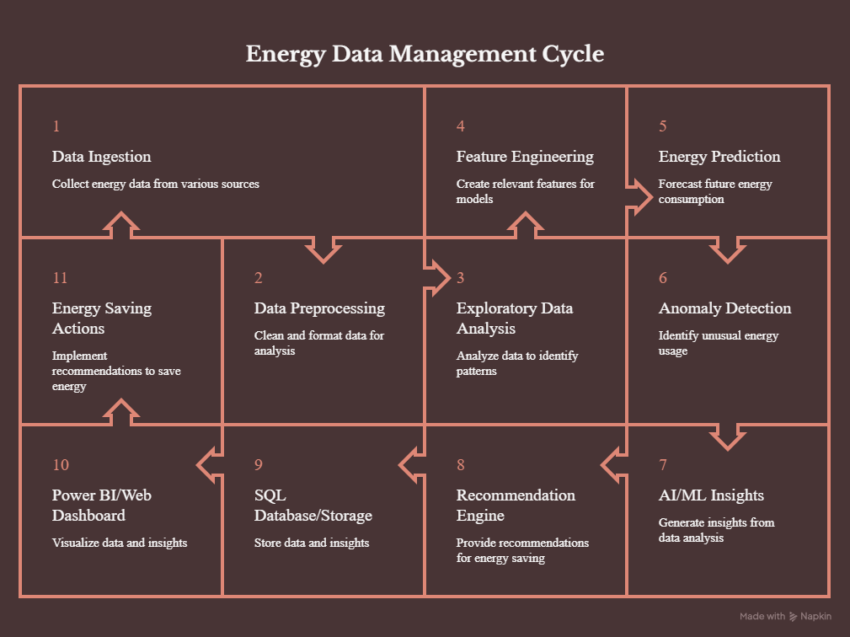
Project flow diagram

Slide 6
Literature Survey
Previous research in the field of smart buildings and energy analytics has shown that Machine Learning can be effectively used to understand and predict energy consumption. Researchers have focused on analyzing factors such as building characteristics, environmental conditions, appliance usage, and historical energy consumption to identify important energy patterns.
Studies also highlight the importance of data preprocessing and Exploratory Data Analysis (EDA) before applying machine learning. Techniques such as missing-value handling, duplicate removal, outlier detection, correlation analysis, feature engineering, and feature selection help improve the quality of the data and prediction results.
Various machine learning models, including Linear Regression, Decision Tree, Random Forest, XGBoost, and CatBoost, have been explored for energy consumption prediction. Comparing these models using MAE, MSE, RMSE, and R² Score helps identify the most suitable model for accurate prediction.
Based on these findings, our project integrates data preprocessing, EDA, feature engineering, feature selection, multiple machine learning models, performance evaluation, and visualization into a single end-to-end framework for intelligent energy consumption analytics in smart buildings.

Slide 7
Literature Survey
Literature Survey – Click here to view research papers
https://link.springer.com/journals
Huotari et al. (2024) – Machine Learning Applications for Smart Building Energy Utilization: A Survey
Himeur et al. (2021) – Artificial Intelligence Based Anomaly Detection of Energy Consumption in Buildings
Seyedzadeh et al. (2018) – Machine Learning for Estimation of Building Energy Consumption and Performance: A Review
Bensaali et al. / related survey – AI-Big Data Analytics for Building Automation and Management Systems

Slide 8
Objectives with justification
1. Develop an End-to-End Energy Analytics Framework
→ Integrate data ingestion, preprocessing, EDA, ML, database and visualization.
2. Analyze Building Energy Consumption
→ Identify consumption patterns based on factors such as temperature, humidity, time,
appliances and building conditions.
3. Develop Energy Prediction Models
→ Predict future energy consumption using Machine Learning algorithms.
4. Detect Abnormal Energy Consumption
→ Identify unusual or unexpected energy usage patterns.
5. Develop Interactive Dashboards
→ Visualize energy consumption, predictions, anomalies and important energy trends.
6. Generate Energy-Saving Recommendations
→ Convert analytical results into practical recommendations for reducing energy wastage.

Slide 9
Research gaps
Limited end-to-end integration of energy data engineering, analytics and machine learning.
Many systems focus only on energy prediction without anomaly detection.
Limited integration of prediction + anomaly detection + recommendations.
Limited conversion of ML results into actionable energy-saving decisions.
Limited use of interactive dashboards for presenting ML-based energy insights.
Limited integration of multiple energy-related datasets into a unified analytics framework.

Slide 10
Novelty
1. Dual Intelligence
The system performs both:
Energy Prediction + Anomaly Detection
rather than focusing on only one.
2. Energy Recommendation Engine
The system converts ML results into recommendations such as:
Reduce unnecessary appliance usage
Identify unusual energy consumption
Optimize high-consumption periods
Identify inefficient usage patterns
3. End-to-End Framework
Integrates:
Data Engineering → Analytics → ML → Database → Dashboard → Recommendations

Slide 11
Feasibility of the Project
1.The project can be developed using:
Python
Pandas
NumPy
Matplotlib
Seaborn
Scikit-learn
SQL/MySQL
Power BI
Streamlit or similar web technologies
Energy datasets provide variables required for consumption analysis and prediction.
2. Economic Feasibility
Most tools are free/open source.
Public benchmark datasets can be used.
No specialized hardware is required for the initial implementation.
Development can be performed using existing computers.

Slide 12
Feasibility of the Project
3. Operational Feasibility
The dashboard can provide:
Energy consumption trends
Prediction results
Anomaly alerts
Energy insights
Recommendations
This makes the output understandable even to non-technical users.
4. Schedule Feasibility
The project can be developed progressively:
Data Collection → Preprocessing → EDA → Feature Engineering → ML → Anomaly Detection → Database → Dashboard → Recommendations → Testing

Slide 13
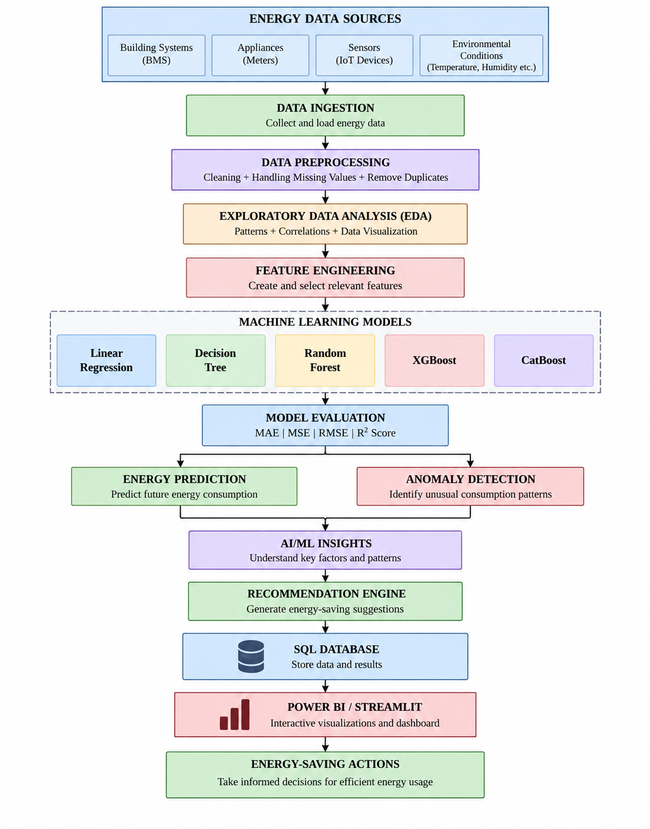
System Methodology & Architecture

Slide 14
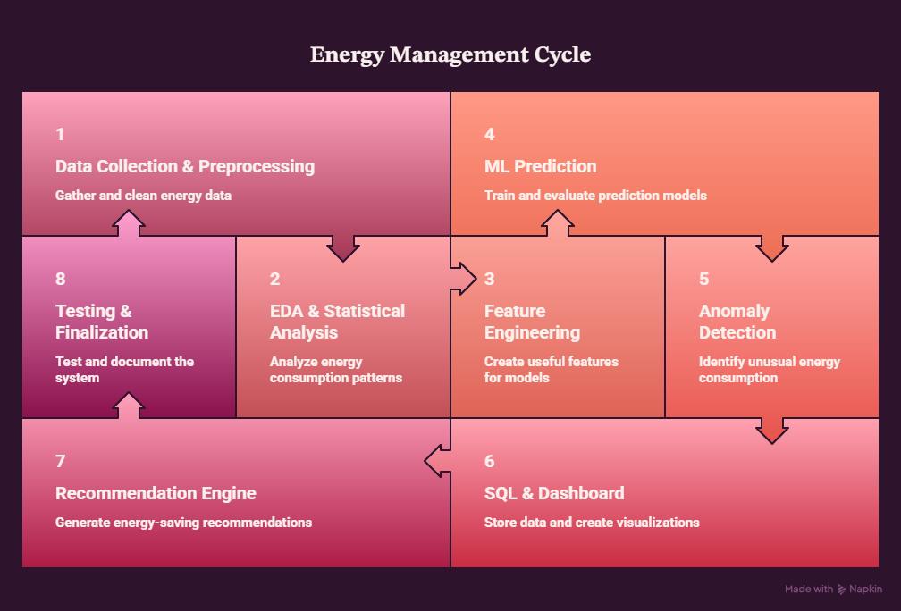
Project Plan

Slide 15
Thank you

